Slide 1
FY 2020 Prevention Outcomes
Annual Report
Prevention Quarterly Meeting
May 6, 2021

Slide 2
The Report
Produced by PIRE
Michael George
Mikella Allen
Al Stein-Seroussi
Data are from July 1, 2019 – June 30, 2020 (FY ‘20)
Summarizes data from many forms of prevention services, but not all
Copies of the final report will be available for download from South Carolina Prevention/Evaluation Resources website: http://ncweb.pire.org/scdocuments/
Correspondence about the report can be addressed to:
Al Stein-Seroussi Michael George
stein@pire.org mgeorge@pire.org
919-265-2616 803-479-3628

Slide 3
The Report
Pre and Post Tests
Environmental Strategies (including county estimates of alcohol and tobacco compliance check buy rates)
Synar (including county estimates of tobacco buy rates)
Alcohol-related crashes
Statewide Youth Substance Use Estimates

Slide 4
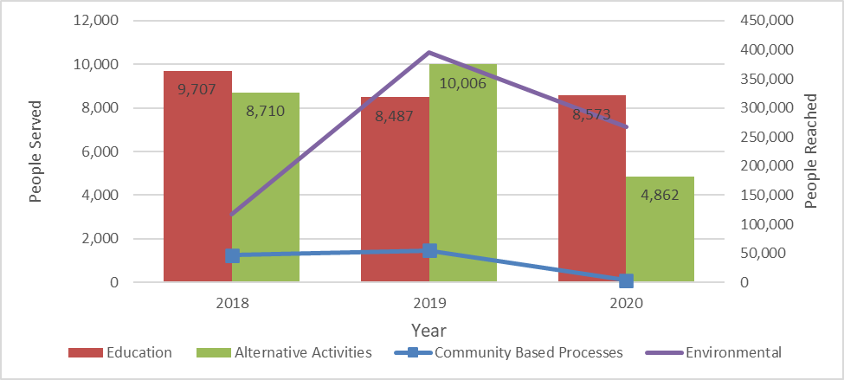
Service Events by CSAP Strategy

Slide 5
PRE AND POST TESTS

Slide 6
Number of Matched Pre-Post Tests by Year

Slide 7
Curriculum Program Data
11 different curricula
Most common programs
Life Skills (793 middle school & 32 high school)
Keepin’ It Real (419 middle school)
Operation Prevention: Rx (114 middle school & 52 high school)
Alcohol-Drug True Stories (156 middle school)
Project TND (89 middle school)
ATOD 101 (65 high school)
Too Good for Drugs (60 middle school)
Class Action (27 high school)
Change from previous years—new and separate MS and HS surveys (will be separating analyses)

Slide 8
Program Demographics: Grade
 | Middle School (n = 1,574) | High School (n = 259)
6th | 53.7% | -
7th | 29.5% | -
8th | 16.9% | -
9th | - | 35.3%
10th | - | 23.3%
11th | - | 32.6%
12th | - | 8.9%

Slide 9
Program Demographics: Race and Sex
 | Middle School (n = 1,574) | High School (n = 259)
RACE
American Indian | 1.7% | 0.4%
Asian | 0.6% | -
Black | 36.2% | 57.5%
Multiethnic | 9.5% | 7.3%
Other | 5.3% | 5.4%
Pacific | 0.3% | -
White | 46.4% | 28.6%
SEX
Female | 45.1% | 46.1%
Male | 53.0% | 51.2%

Slide 10
Risk Factor Data
Risk-Factor Measure (All Scale Scores Range from 0 – 3)ª | Middle School |  |  |  | High School
 | Pre-Test Average | Post-Test Average | Percent Change | Pre-Test Average | Post-Test Average | Percent Change
Perceived Risk | 2.24 | 2.33 | 3.99** | 2.08 | 2.19 | 5.19**
Decision-Making | 1.92 | 1.89 | -1.41* | 1.82 | 1.87 | 2.46
Disapproval of Use | 2.61 | 2.62 | 0.34 | 2.10 | 2.19 | 4.24**
Perceived Peer Norms | 2.42 | 2.45 | 1.29* | 1.62 | 1.82 | 12.37**
Perceived Parental Attitudes | 2.81 | 2.80 | -0.12 | 2.53 | 2.55 | 0.68
ª Higher scores are more favorable. * Pre- and post-test averages are marginally significantly different (p<.10). ** Pre- and post-test averages are significantly different (p<.05). Green cell denotes significant reduction in risk; red cell is significant increase in risk.

Slide 11
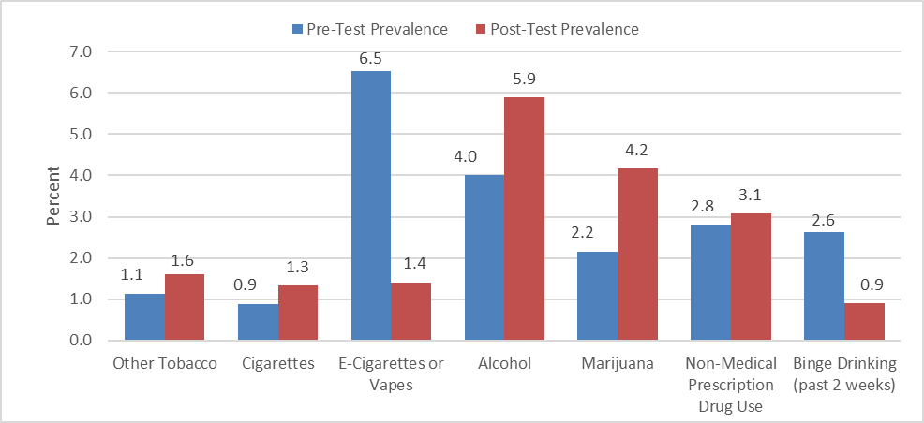
Substance Use Measures, Middle School
*
*
*
*

Slide 12
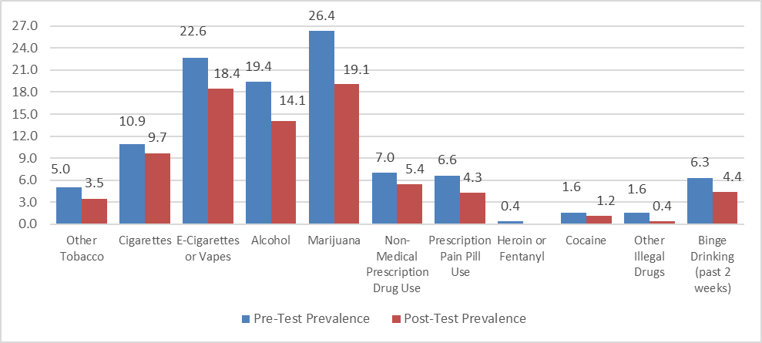
Substance Use Measures, High School
*

Slide 13
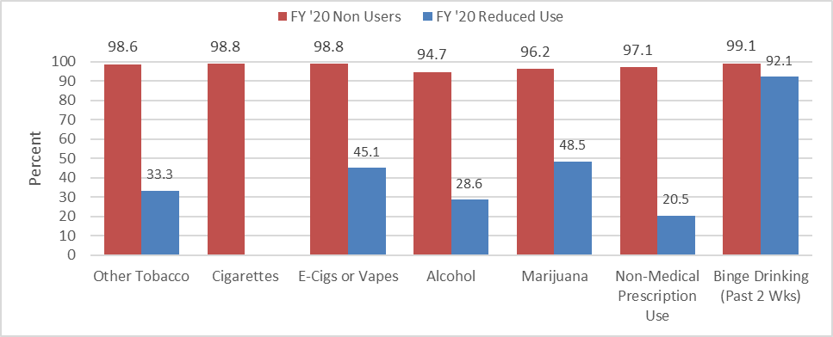
Non-Users Who Remained Non-Users and Users Who Reduced Use, Middle School

Slide 14
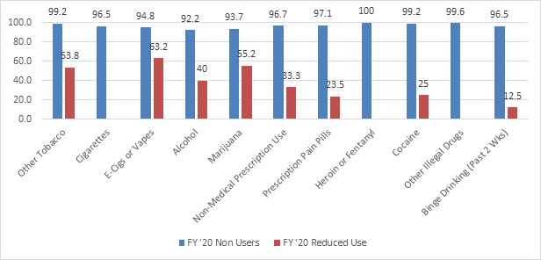
Non-Users Who Remained Non-Users and Users Who Reduced Use, High School

Slide 15
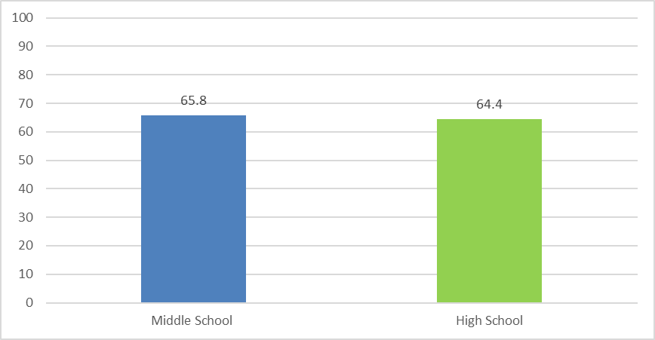
Parent Child Communication and Exposure to Prevention Messages, FY ’20

Slide 16
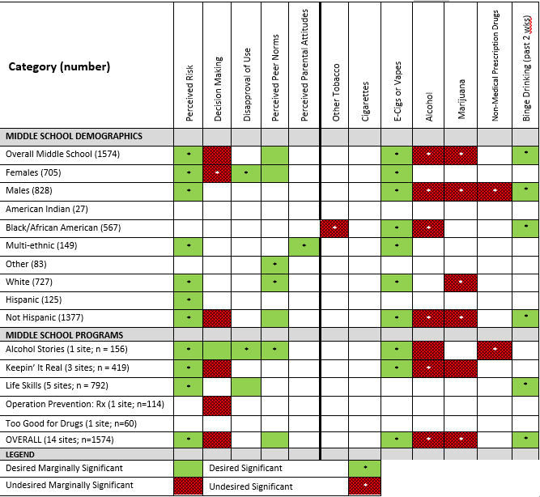
Summary of Program Outcomes:Middle School
Notes:
Michael, I asked Mikella to double check these tables because I noticed at least one error. So we will want to replace this when she is done.

Slide 17
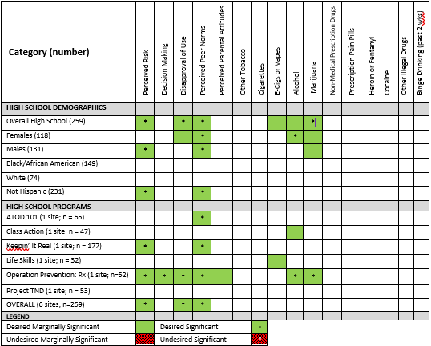
Summary Program Outcomes:High School
Notes:
Same as previous comment.

Slide 18
Methodological Issues
Floor and Ceiling Effects
Lack of Comparisons
Attendance Bias
Short Duration between Pre and Posts
Maturation Effects

Slide 19
ALCOHOL AND TOBACCO ENVIRONMENTAL PREVENTION STRATEGIES

Slide 20
Types of Environmental Strategies
Compliance Checks (alcohol = 4,858; tobacco = 357)
Bar Checks (213)
Shoulder Taps (9 operations)
Public Safety Checkpoints (395)/Saturation Patrols (161)
Controlled Party Dispersal/Party Patrols (103)

Slide 21
Types of Environmental Strategies (cont.)
PREP Merchant Education (1,128)
Diversionary or Court-mandated Youth Programs (247 in alcohol; 379 in tobacco)
AET Awareness Activities (e.g., town hall meetings, casual contacts, education sessions, earned media, social media, community contacts with youth and retailers)
AET Training (8 training sessions, 122 individuals)

Slide 22
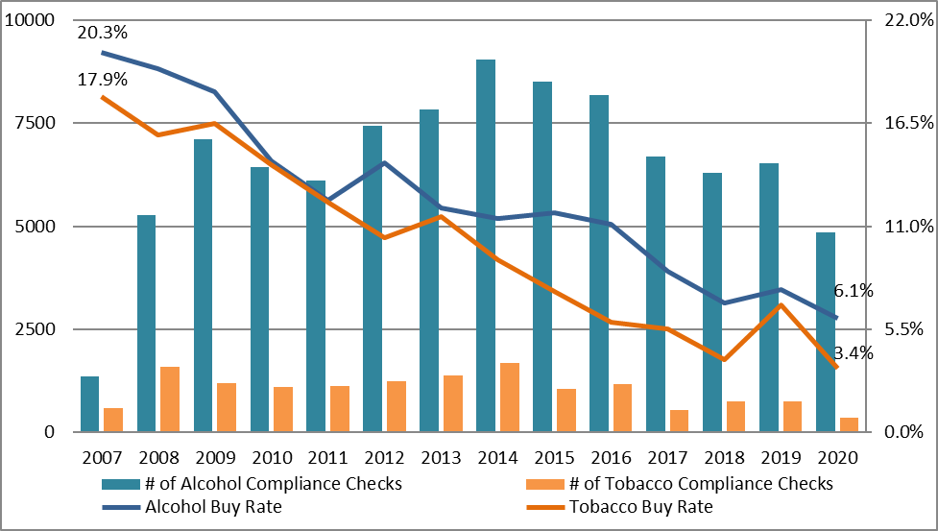
Compliance Checks

Slide 23
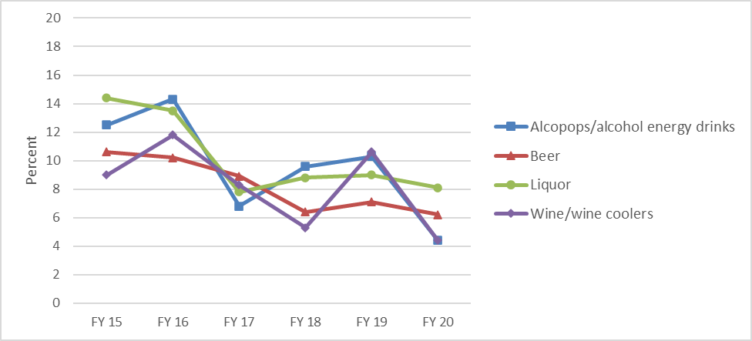
Alcohol Buy Rates by Type of Product

Slide 24
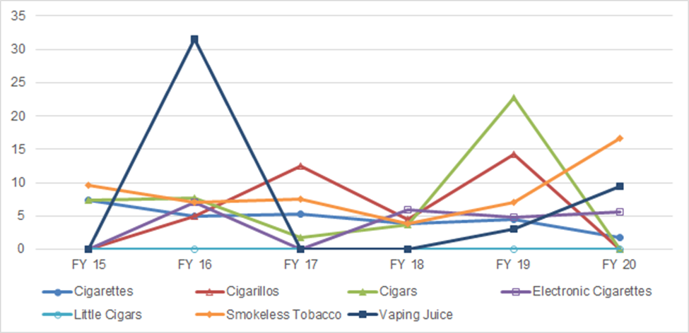
Tobacco Buy Rates by Type of Product

Slide 25
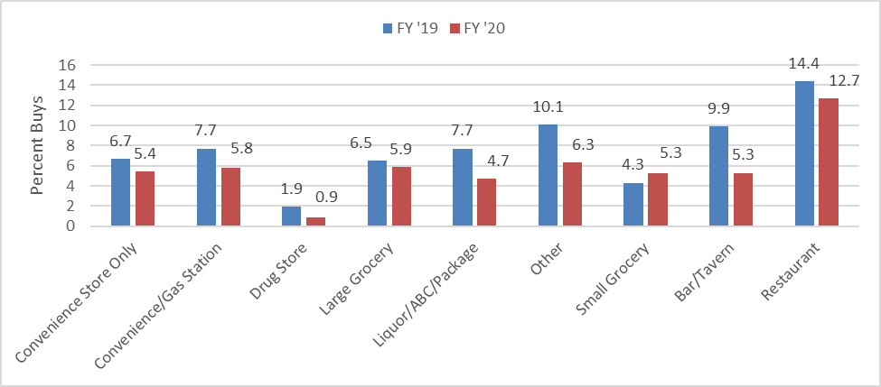
Percentage of Completed Alcohol Sales FY 19 and FY 20

Slide 26
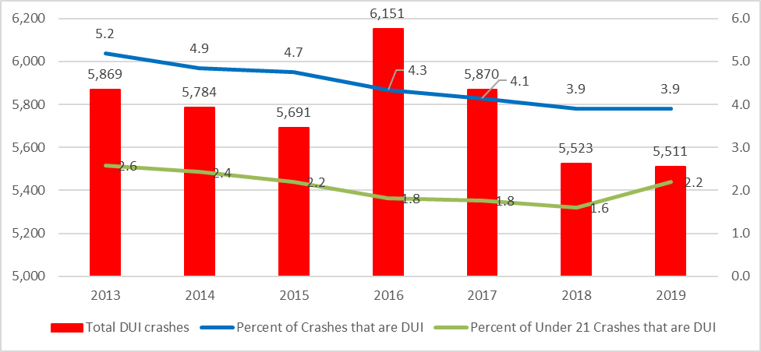
Alcohol-Related Traffic Crashes 2013 - 2019

Slide 27
Questions?
Al Stein-Seroussi stein@pire.org 919-265-2616
Michael George mgeorge@pire.org 803-479-3628
Mikella Allen mallen@pire.org 803-896-1167

